Slide 1
Easy Counselling App Flow
A step by step walkthrough of the app.

Slide 2
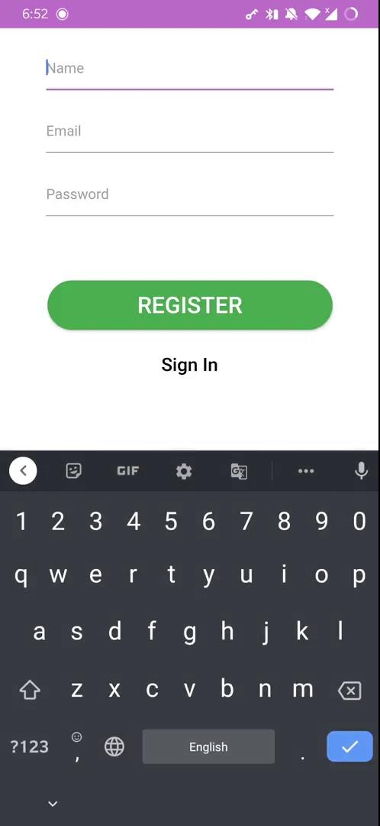
Start-up Screen
First time users

Slide 3
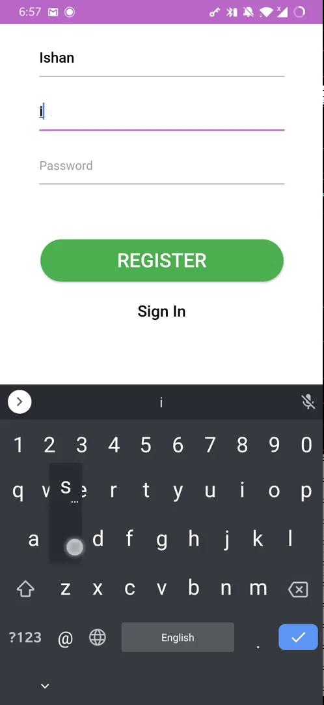
Registration- Using VIT-Email

Slide 4
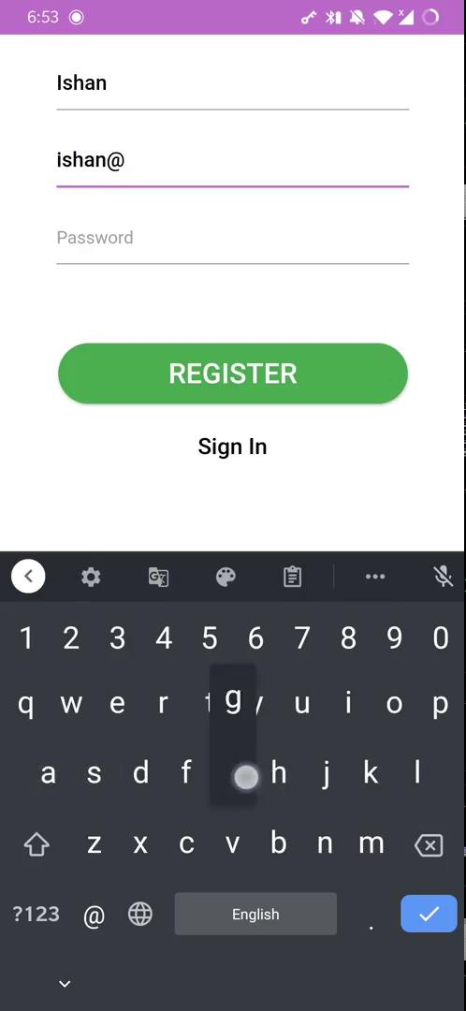
Registration -
Using Non VIT- Email

Slide 5
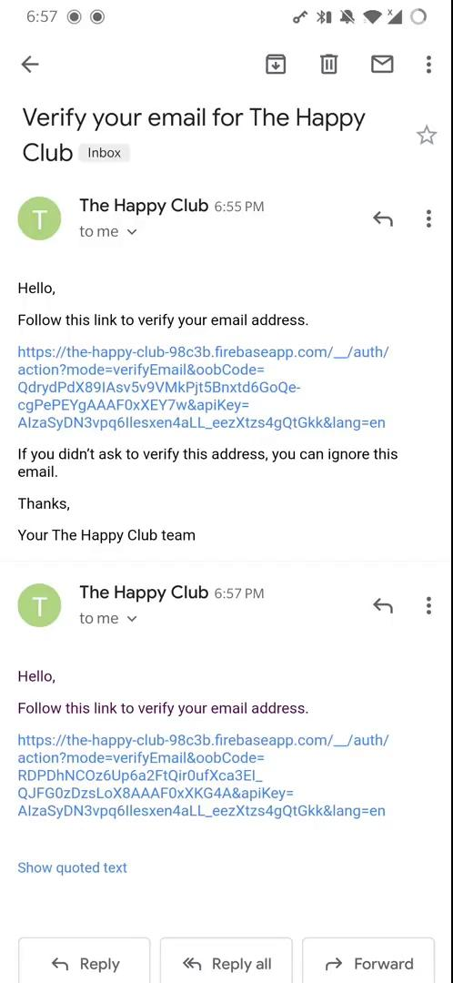
Email Verification

Slide 6
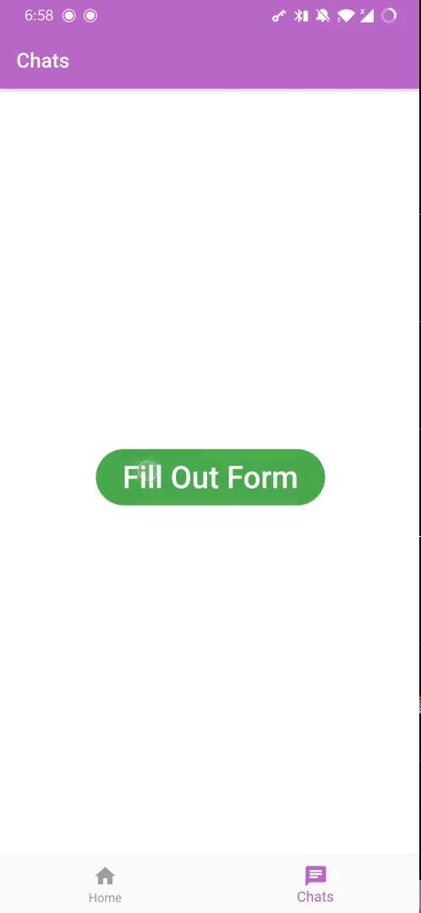
Forms and requesting
Counsellor

Slide 7
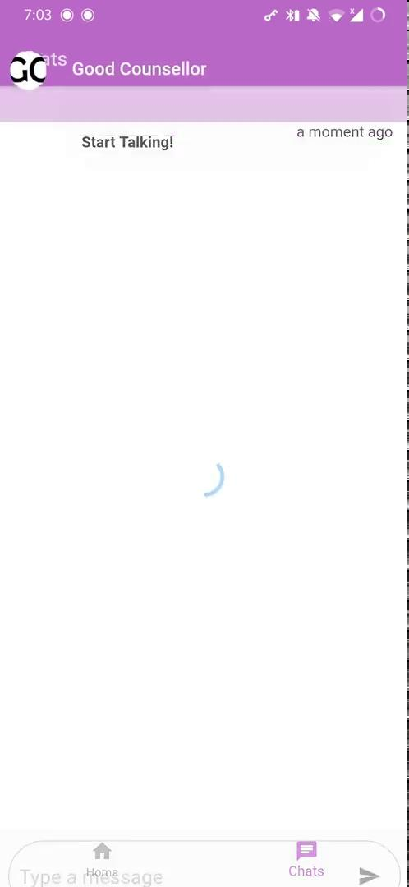
Chats

Slide 8
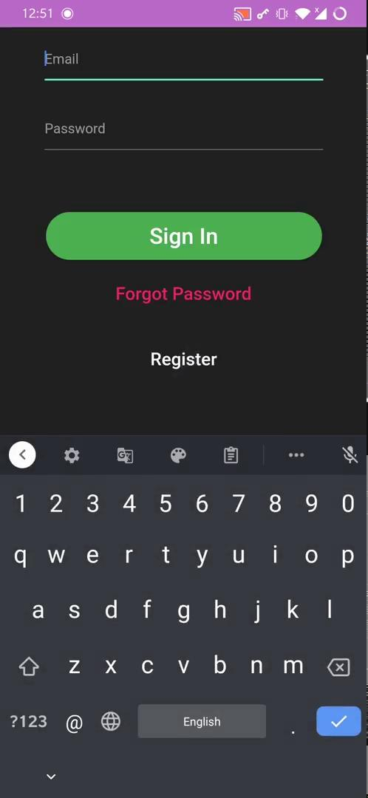
Dark Mode and Signing In/Out

Slide 9
Please feel free to provide feedback and ask questions!

